Slide 1

From the field to data interpretation
Pilar Fernandez
pilar.fernandez@wsu.edu
A guide to good practices on data collection, management, statistical analysis and mapping.

Slide 2
Road map
1st block: Data management 101. Good practices for data collection and data management
2nd block: Generalities of data analysis. How to turn a spreadsheet into information.
Notes:
1st – 3rd block can be more interactive using Mosquito data
1st block: Study design to collect data on the field, common issues found in data collection (mosquito examples). Trade-off between quality of the data and including more sites.
Maria and Pilar
2nd block: Data management. How data is “translated” into variables. Data entry in Excel, test for quality.
Ángel
3rd block: Generalities of data interpretation. Types of data: binary (presence/absence)/ numeric (discrete: abundance/ continuous: climatic variables). Distinguish between the outcome and explanatory variables and types of analisis depending on the outcome. Introduce the concept of models.
Pilar
4th block: Examples and applications of models. Introduce models that include landscape variables and spatial dimension. Risk maps.
Maria
5th block: Predictive models. How do we use the models to predict and walk through the data library, using models that include climatic variables as an example. Introduce R0 model.
Ángel

Slide 3
Data management
Case study
Mosquito surveillance data:
Data from 7 reporting jurisdictions
Suffolk, Nassau, New York City, Westchester, Rockland, New York State Department of Health, Connecticut Agricultural Experiment Station

Slide 4


First… why do we sample vector populations?
Objetives:
Describe
Explain
Predict
Control?
Number of individuals in a certain location in certain time
How do vector populations change?
Interaction with other species (hosts)
Within species interactions
Interactions with the environment
Distribution
Density

Slide 5
What do we need to take into account?
Sampling effort
Sampling methodology
Field data collection practices

Slide 6
What is the sampling effort?
The probability of sampling an individual increases with the sampling effort.
It depends on the number of sampling units and ,for example, the sampling time:
How many traps and for how long
Implications
Abundance of mosquitoes trapped vary with effort
Species composition changes (night vs. daytime)

Slide 7
Sampling methodology
Gravid (N=6)
Light (N=11)
BG (N=12)
Implications
Different efficiency between traps

Slide 8
Data collection and management
Creating relational databases:
Why is it important to have datasets that can talk to one another?
Important considerations:
The importance of “ID” or unique variables which allow you to create relational databases
Consistency in the formatting of variables such as “Address”, “Date”, “GPS Coordinate” (makes data cleaning process a lot smoother)
Regarding GPS coordinates: the projections we use is important and the precision of the coordinates.
Record the sampling effort to increase precision in the estimation of mosquito density/abundance.

Slide 9
Design your Excel file
Think ahead!
Unique information in each row and column
Consistent column names, coded values and their meaning
Keep a “raw” database and a separate “clean” database
Create a data library (or dictionary)

Slide 10
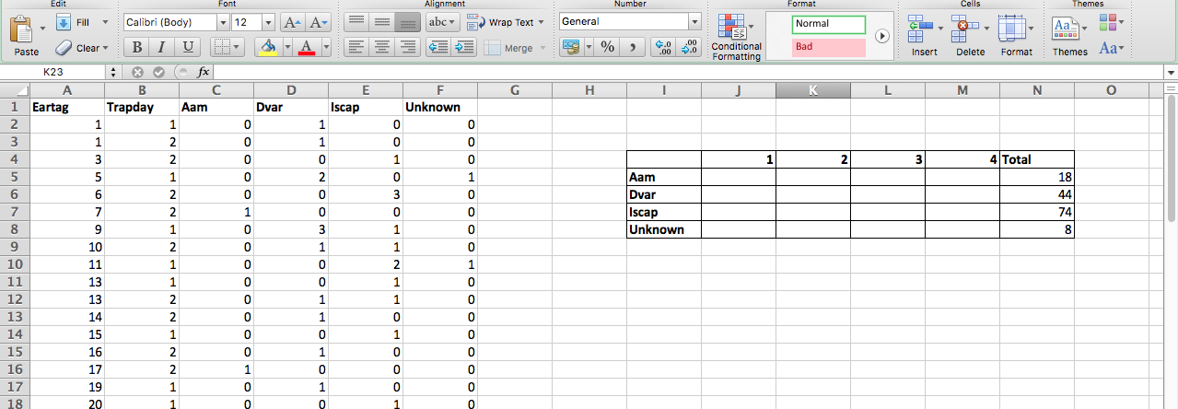
No no noooooo

Slide 11
Data dictionary
Help your future self! (and others)
Variable name
Variable definition
How the variable was measured (if applicable)
Data unit
Data format
Coded values and their meanings
Zero vs. null

Slide 12
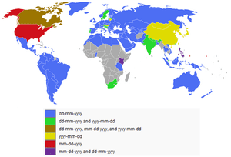
Date formats
Use standards!
ISO 8601
By day: YYYY-MM-DD,
ex. 2019-05-16 or 20190516
By month: YYYY-MM
By datetime: YYYY-MM-DDThh:mmX
ex. 2019-05-16T13:00UTC-05
X= UTC time offsets - https://en.wikipedia.org/wiki/List_of_UTC_time_offsets

Slide 13

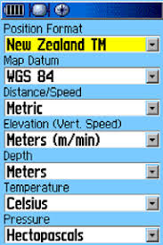
Handling GPS data: from the field to the database
Download data from GPS device
Record Coordinate system used: Setup>Units

Slide 14
2 types of coordinate systems:
Geographic Coordinate System (latitude and longitude)
Projected Coordinate System (X and Y).
Datum:
A datum is a specific, known point on or in the Earth that is used for reference.
A projection uses the datum as a point of reference, it's location on Earth.
ex. WGS84
Position format:
Geographic Coordinate System (latitude and longitude)
degrees, minutes, and seconds
ex. 40° 26′ 46″ N 79° 58′ 56″ W
degrees and decimal minutes
ex. 40° 26.767′ N 79° 58.933′ W
decimal degrees
ex. 40.446° N 79.982° W.
S and W can be replaced by – (minus sign)
Projected Coordinate System (X and Y)
UTM zone, East-West position in meters (X), North-South position in meters (Y)
ex. 10S 706832 4344683

Slide 15
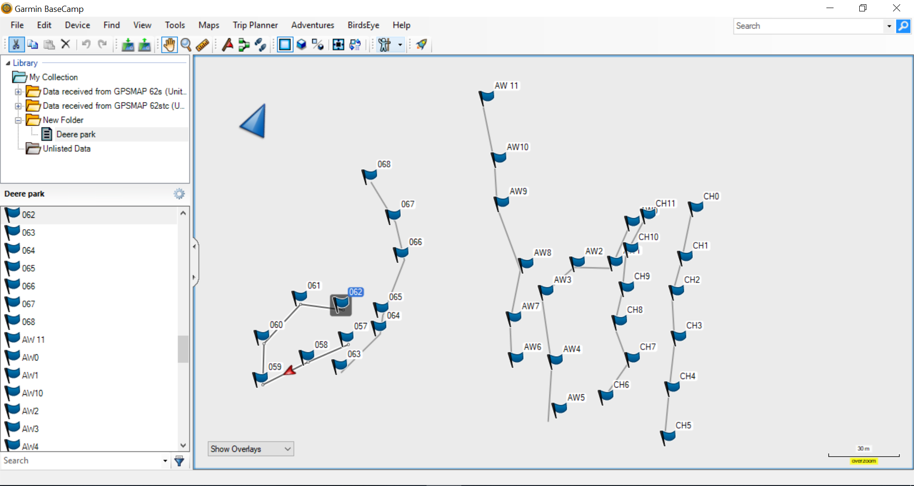

Slide 16
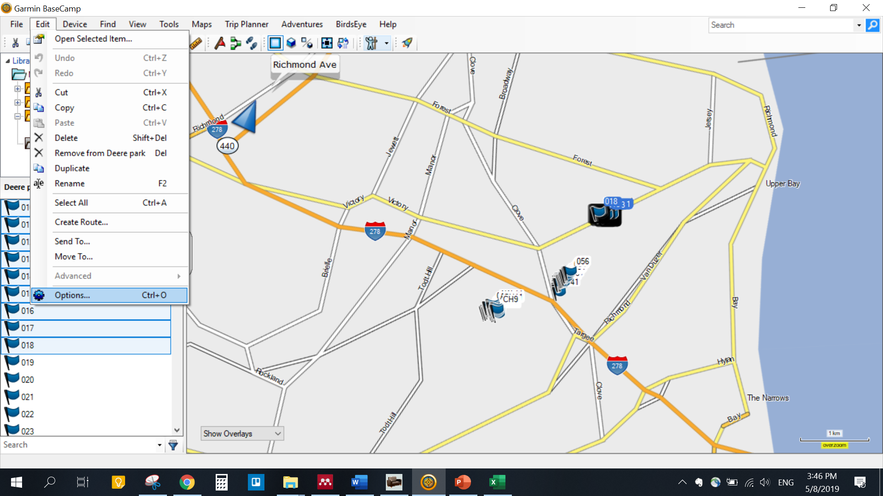

Slide 17
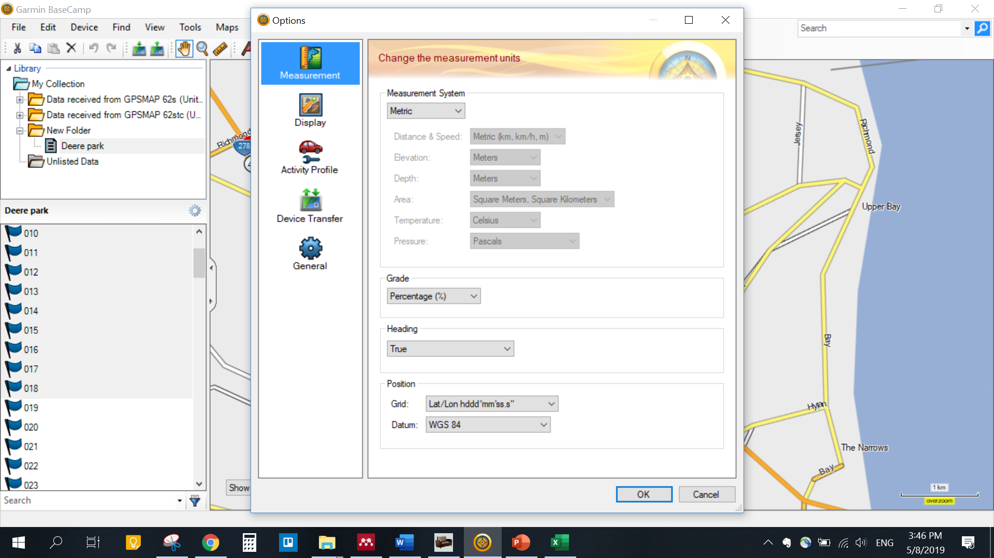

Slide 18
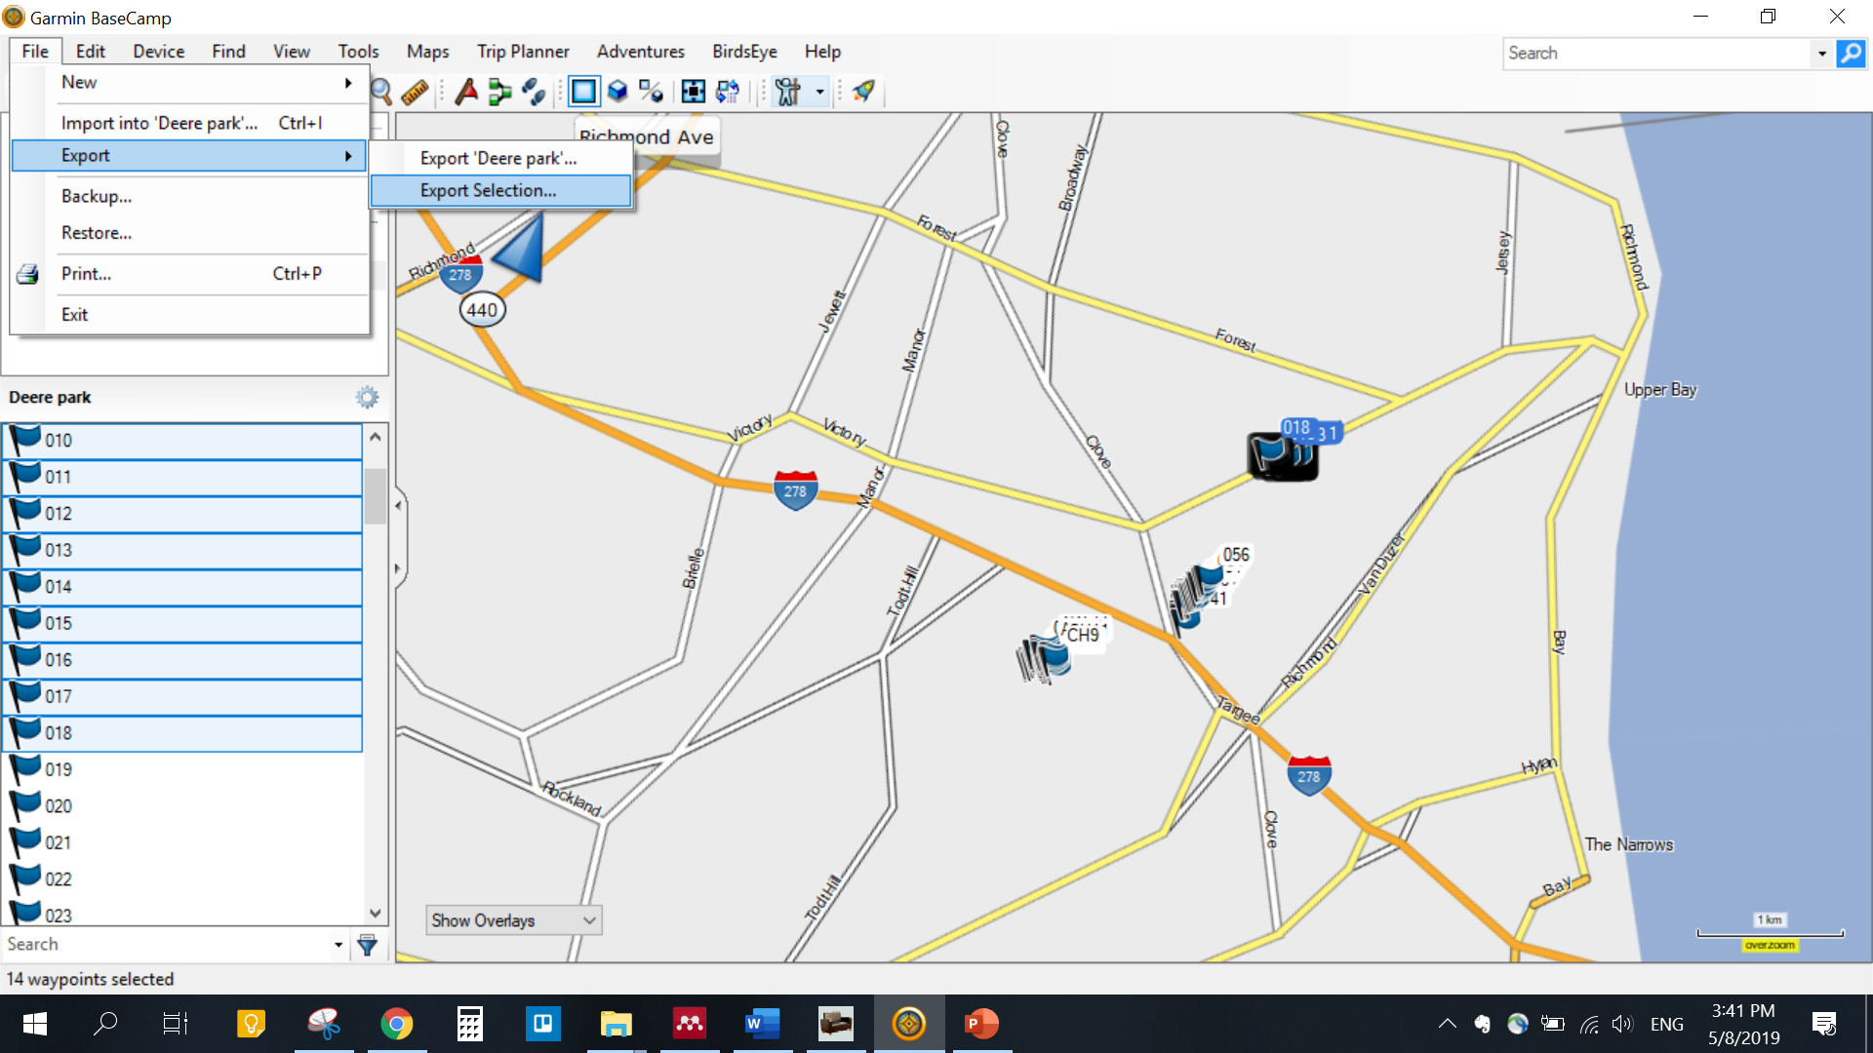

Slide 19
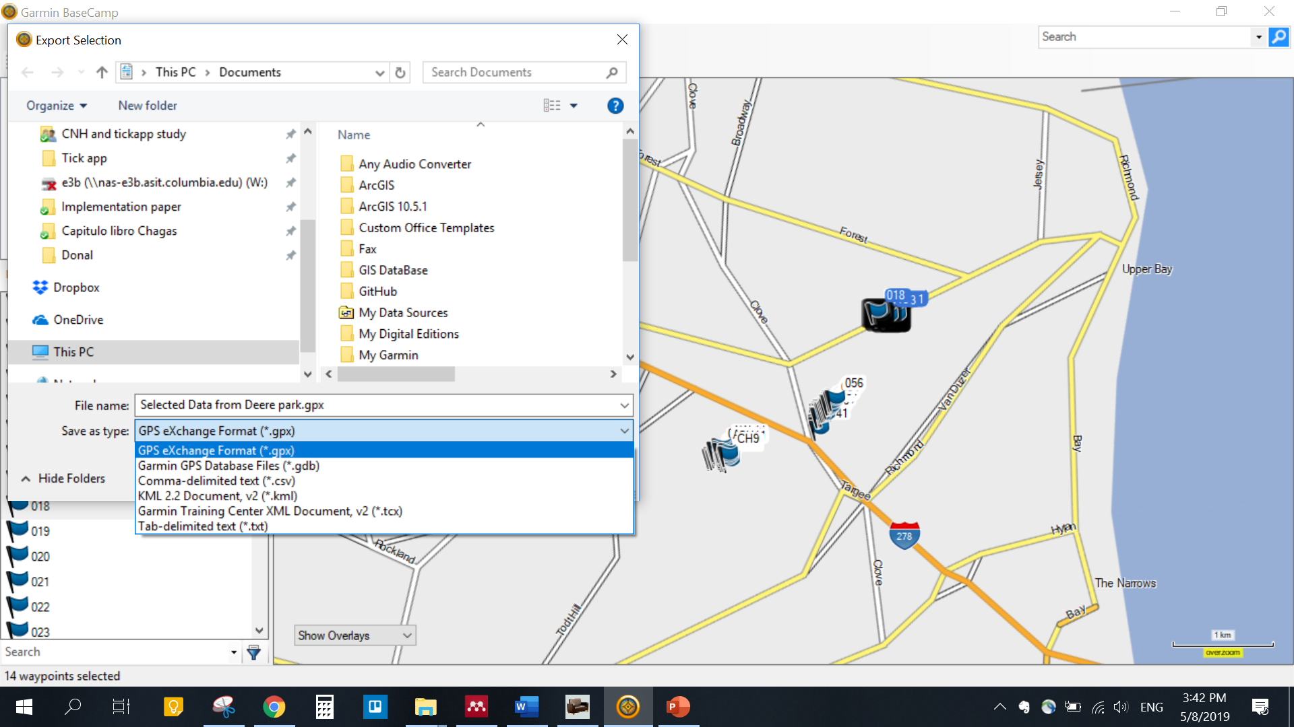

Slide 20
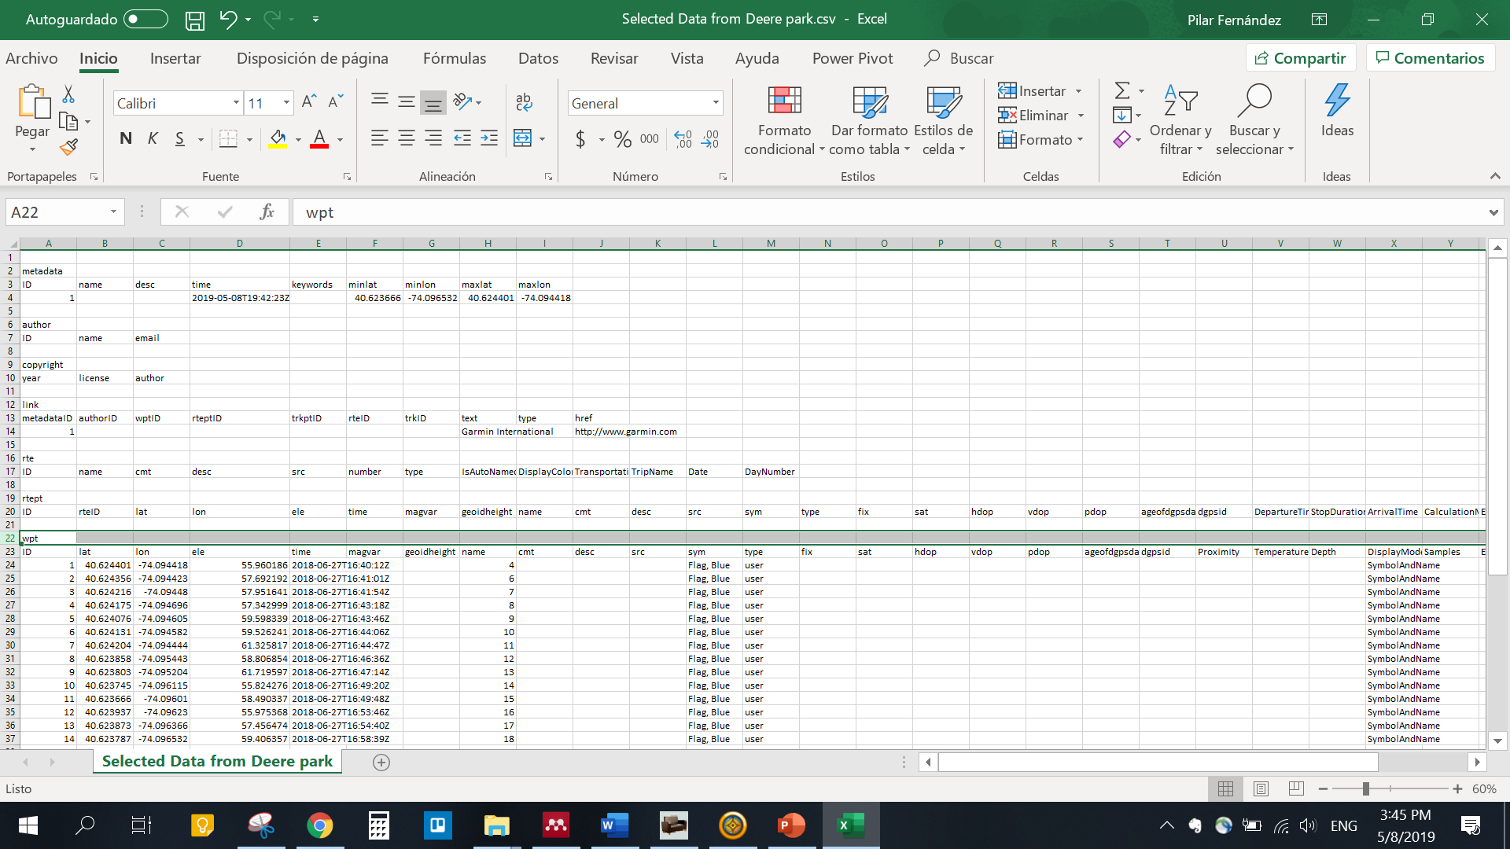

Slide 21
Some useful Excel tricks
Pivot table
Merge databases using Vlookup

Slide 22
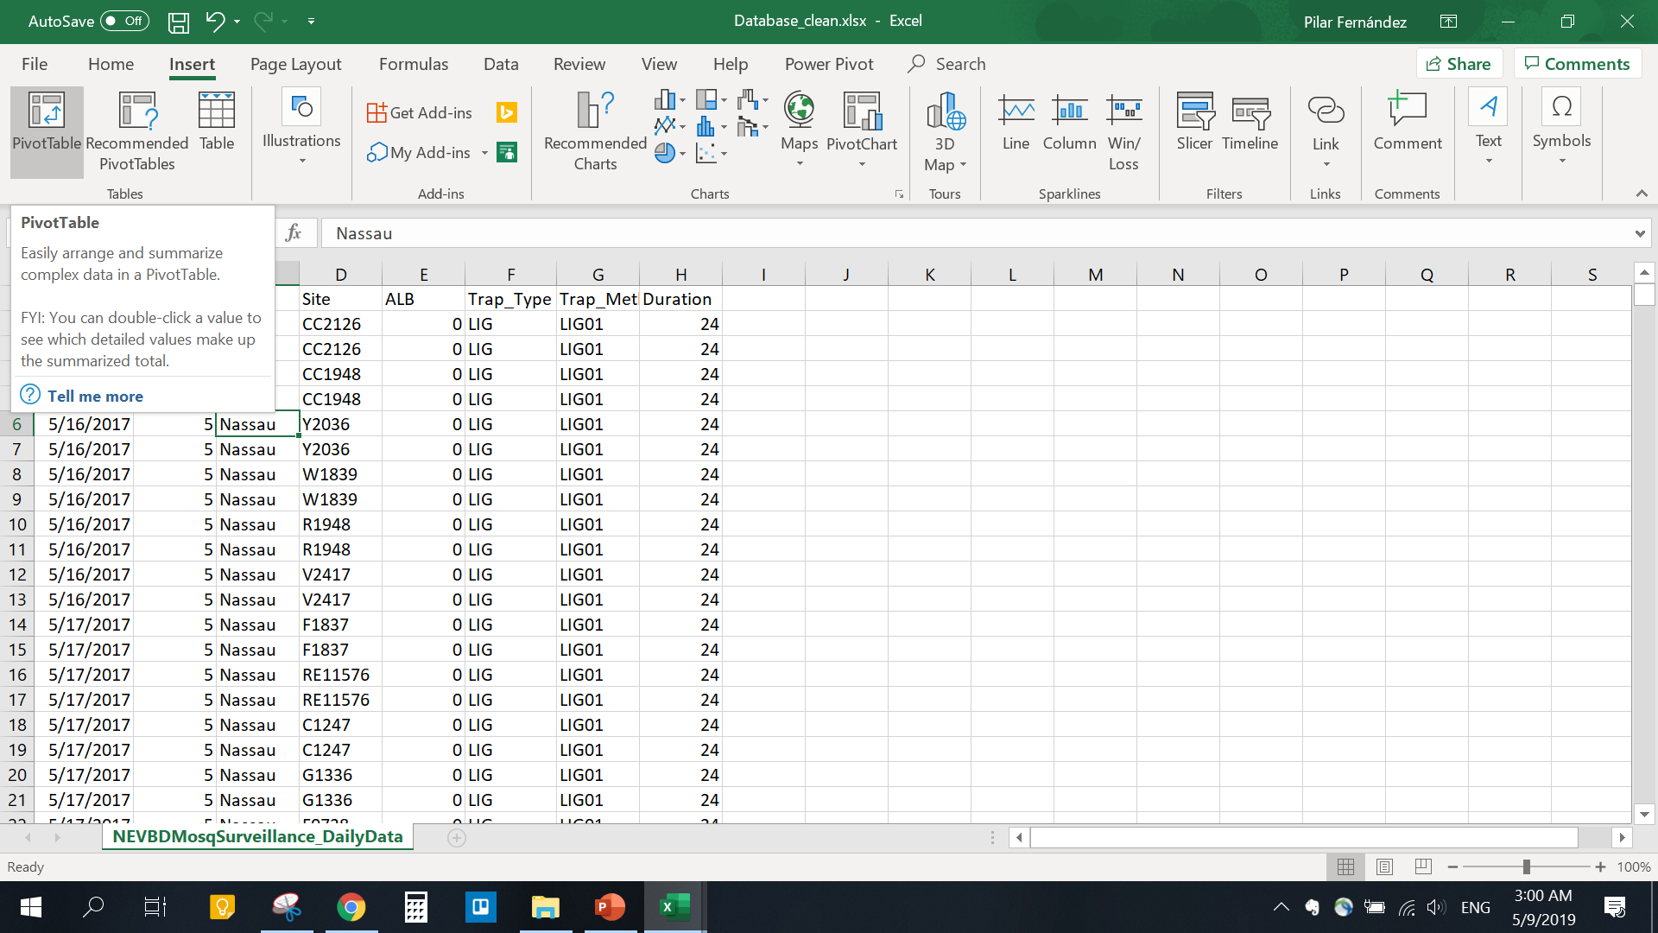
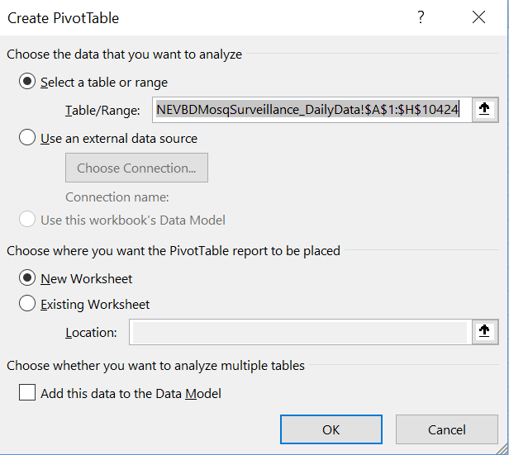

Slide 23
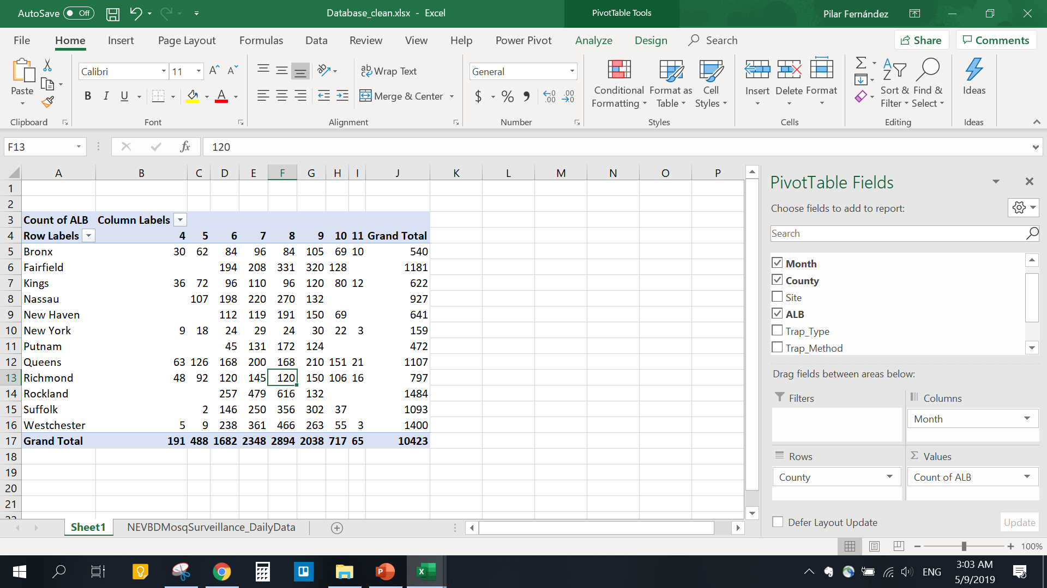

Slide 24
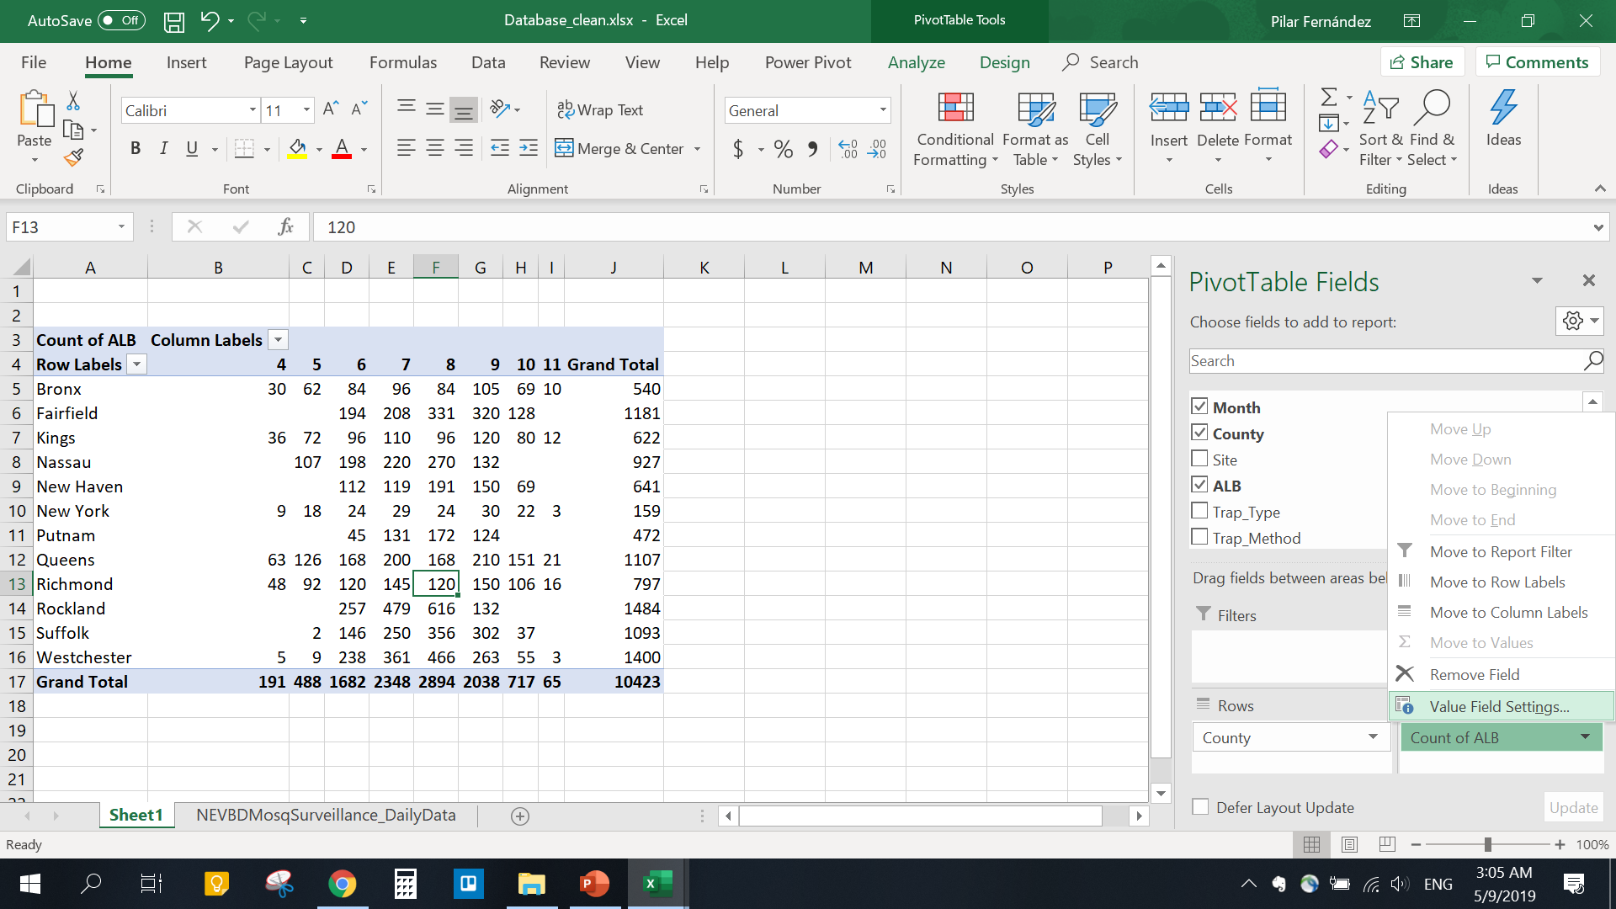
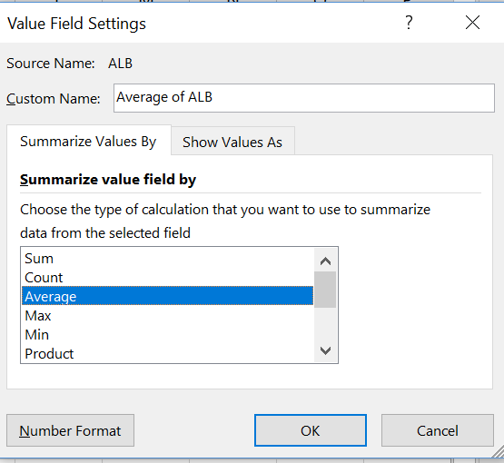

Slide 25
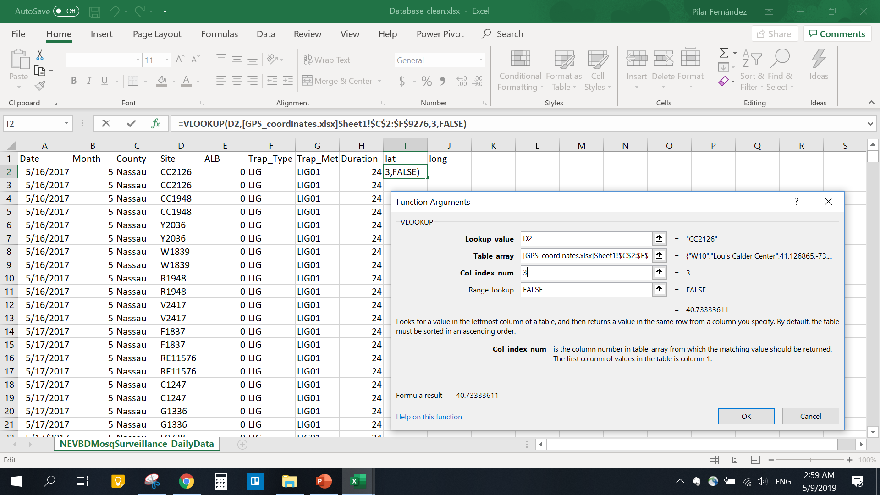

Slide 26
Exercise – 5 min
Explore “Database_raw.xlsx” and take note of any problems that you think may appear if we try to merge the data.
Observe differences in:
Sampling Effort
How many traps and for how long?
Sampling Methodology:
Which traps and baits were used?
Data Collection
How was the data recorded?

Slide 27
What did you find?
 | Location 1 | Location 2 | Location 3 | Location 4 | Location 5
Coordinate system
Location of the GPS point (town or trap?)
Unique ID
Long vs. wide database

Slide 28
Generalities of data analysis.
Types of variables
Descriptive analysis: comparisons or correlations.
Distinguish between the outcome and explanatory variables.
Describe the strength of a relationship (2) or model the determinants of and predict the likelihood of an outcome (3)?
Notes:
1st introduce the data – each database first and talk about the differences for 5 min and then show the clean database
Then talk about the differences observed and talk about each one.

Slide 29
Type of variables
Numeric
Categorical
Nominal
Ordinal
Continuous
Discrete (count)
Temperature
Number of mosquitoes
Type of trap
Likert scale
Time

Slide 30
Comparisons
Criteria for test selection:
What type of variables do we want to compare?
How many comparisons groups do we have?
Are comparison groups independent or paired (e.g. before/after)?

Slide 31
Numeric or categorical?
Numeric
Categorical
Number of groups to compare?
Correlation between 2 numeric variables?
Chi-square or Fisher exact test
Spearman or Pearson correlation
2
3 or more
Independent groups or paired (ex. before-after)?
ANOVA (if normal distribution)
Kruskal-Wallis (non-parametric test)
Independent
Paired
t test
(if normal distribution)
Mann-Whitney
(non-parametric test)
Paired t test
(if normal distribution)
Wilcoxon
(non-parametric test)

Slide 32
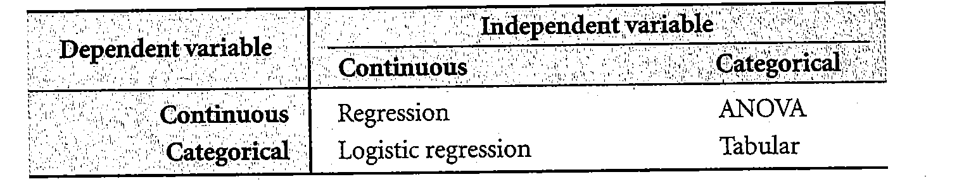
Dependent and independent variables.
What explains changes in the outcome
What we want to explain / The outcome

Slide 33
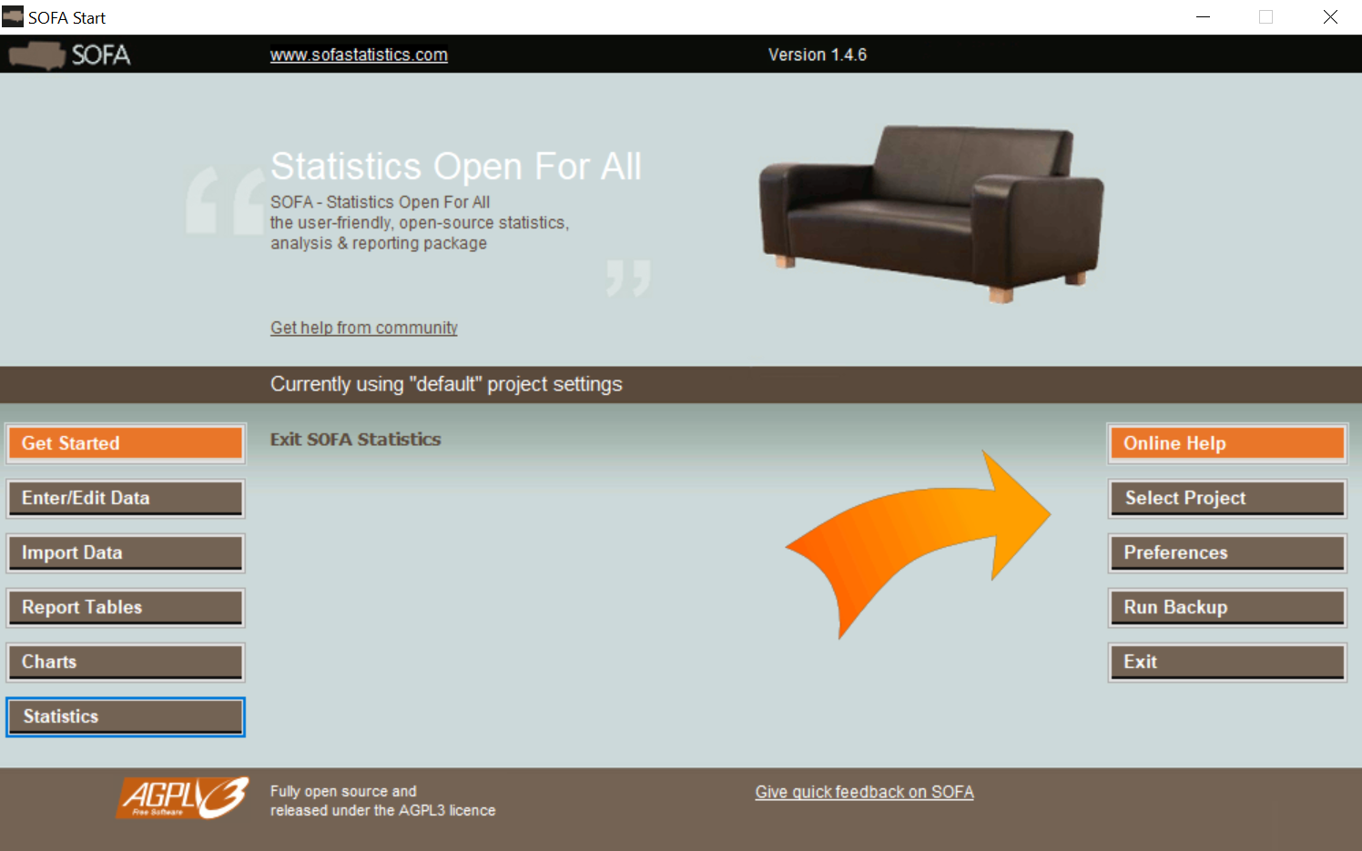
DOWNLOAD: https://www.sofastatistics.com/downloads.php

Slide 34
Take-home messages
Design the database that follows good standards for data collection before you collect the data.
Construct a data dictionary!
Keep a clean copy of your database (Raw data) separated from your working database.
To decide which statistical test is appropriate, think about the type of outcome variable, if they are paired and the number of groups you want to compare.

Slide 35

Visualizations!

Slide 36
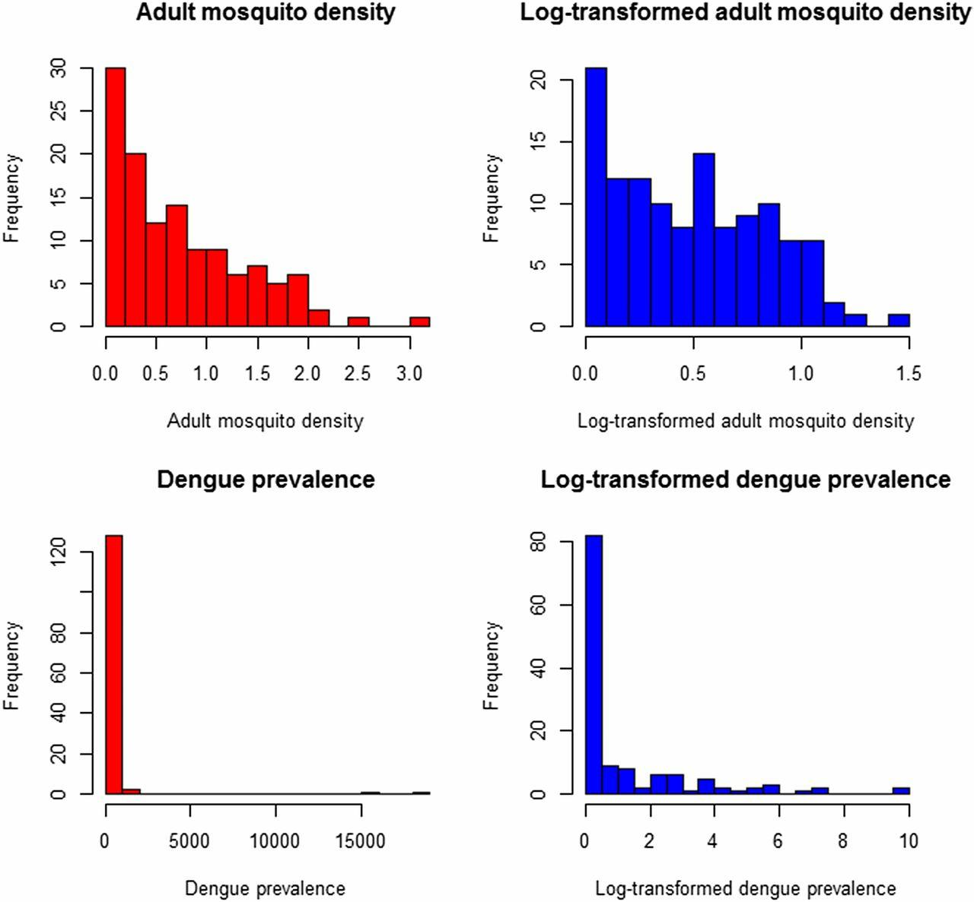
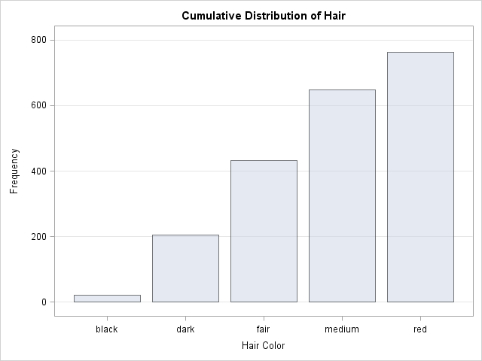
Distribution of outcome
Only numeric data
Only categorical data
Graph bar
Histogram

Slide 37
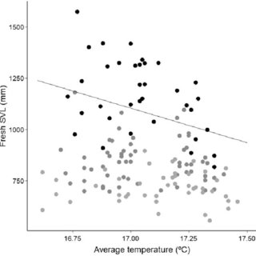
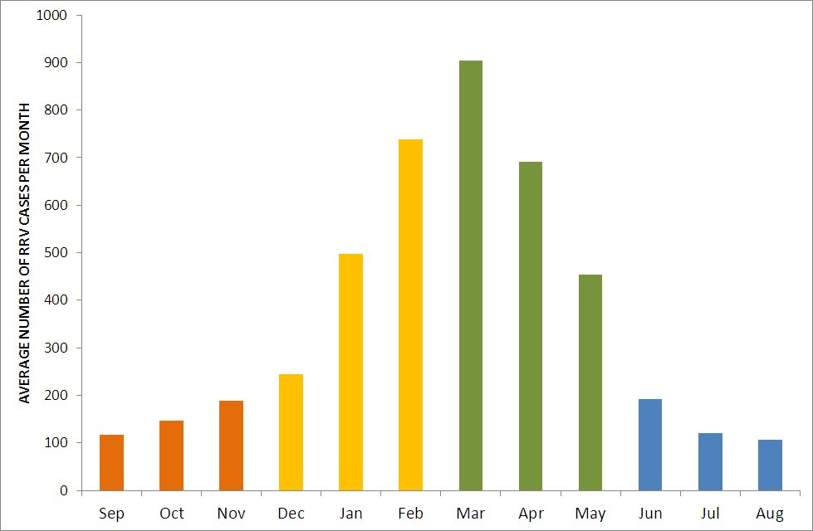
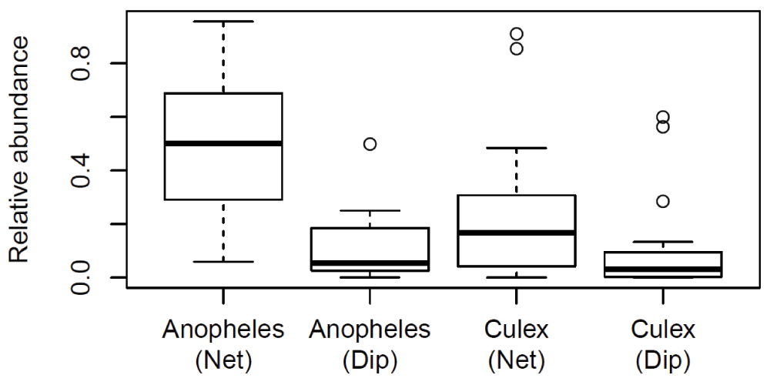
Relationship between outcome and predictor
Continuous vs. continuous
Continuous or discrete vs. categorical
Scatter plot
Graph bar
Box plot

